Slide 1
Module 1: Lesson 1 – Conventional Tillage

Slide 2
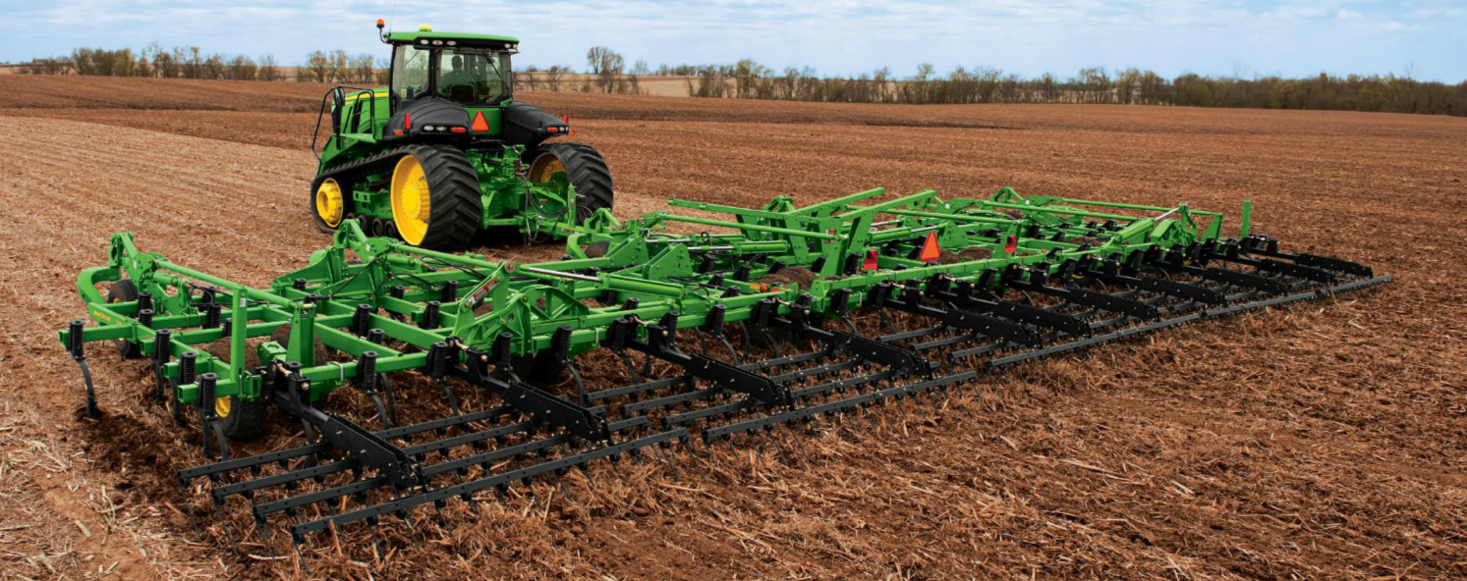
Introduction: What is Tillage?
Tillage is the mechanical disturbance of the soil in preparation for planting
Purpose
Seedbed Preparation
Weed Control
Residue Management
Soil Aeration
Notes:
Before planting, farmers often prepare the soil through a process called tillage, which is the mechanical disturbance of the soil to create a better growing environment for crops. Tillage can be done using a variety of equipment, such as plows, cultivators, and harrows, depending on the specific needs of the field.
The main purposes of tillage include:
Seedbed Preparation – Tillage helps create a smooth, loose, and well-aerated seedbed, ensuring good seed-to-soil contact, which is essential for uniform germination and early crop growth.
Weed Control – By disturbing the soil, tillage can help bury or uproot weeds, reducing competition for water, nutrients, and sunlight.
Residue Management – Crop residue left over from the previous harvest can be incorporated into the soil, which helps with decomposition and nutrient cycling.
Soil Aeration – Tillage can loosen compacted soil, allowing better water infiltration and root development, which is crucial for healthy plant growth.
While tillage has many benefits, it is also important to balance soil disturbance to prevent issues like erosion and loss of soil structure. In this lesson, we’ll explore different types of tillage systems and how they impact soil health and crop production

Slide 3
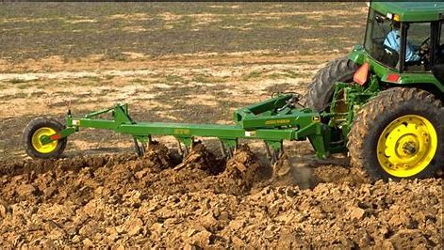
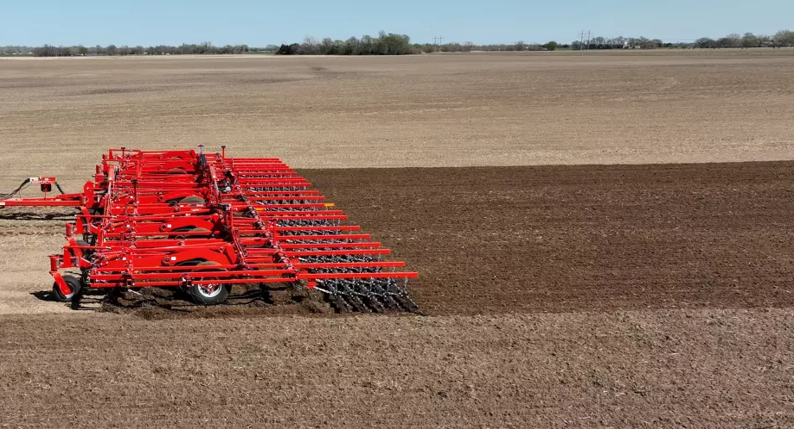
Types of Tillage
Primary Tillage - Deep and Heavy Soil Disturbance
Secondary Tillage - Shallow and Fine Soil Preparation
Notes:
There are two main types of tillage that farmers use to prepare their fields: Primary Tillage and Secondary Tillage. Each serves a different purpose in the planting process.
Primary tillage involves deep and heavy soil disturbance. This is the first major tillage operation after the previous crop is harvested. It breaks up compacted soil, buries crop residue and weeds, and improves water infiltration. Implements like moldboard plows, chisel plows, and rippers are commonly used for this purpose. As you can see in the image on the left, primary tillage turns over large amounts of soil, which helps reset the field for a new growing season.
Once primary tillage is completed, farmers may follow up with secondary tillage, which provides shallow and fine soil preparation. This step smooths out the seedbed, breaks up large soil clods, and improves seed-to-soil contact for better germination. Tools like field cultivators, disk harrows, and rolling baskets are often used to refine the soil before planting. The image on the right shows secondary tillage, where the soil is being finely prepared for uniform planting conditions.
Ask Students:
Q: What differences do you notice between these two fields?
A: The left field has large clumps of dirt and looks very rough. The right field looks smoother, and the dirt clumps are finer
Q: Which field looks better to plant in?
A: The right field.

Slide 4
What is Primary Tillage?
Primary tillage is the first soil tillage operation after the last harvest.
Effects of primary tillage
Breaks up compacted soil layers
Buries weeds and crop residue
Enhances water infiltration
May cause soil erosion if done excessively
Depth: Typically 6-24 inches deep
Common primary tillage implements include
Moldboard Plow
Chisel Plow
Ripper/Subsoil Plow
Notes:
Now, let’s take a closer look at primary tillage, which is the first soil tillage operation after the last harvest. This is a critical step in preparing a field for planting, as it helps break up the soil and manage crop residue.
Primary tillage has several key effects:
It breaks up compacted soil layers, which is essential for improving root growth and water movement.
It buries weeds and crop residue, helping to create a clean seedbed for the next crop.
It enhances water infiltration, making it easier for rainfall and irrigation to penetrate the soil.
However, if done excessively, primary tillage can cause soil erosion, removing valuable topsoil and organic matter.
Primary tillage is typically performed at a depth of 6 to 24 inches, depending on the soil type and the equipment used.
Some of the most common primary tillage implements include:
Moldboard Plows, which completely turn over the soil, burying residue and disrupting weed growth.
Chisel Plows, which loosen compacted soil while leaving some residue on the surface to help prevent erosion.
Rippers or Subsoil Plows, which break up deep compaction layers without inverting the soil, improving drainage and root penetration.

Slide 5
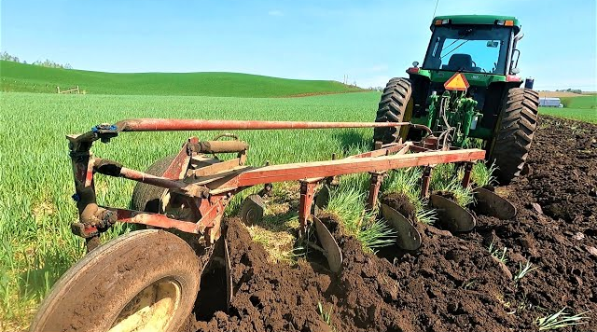
Moldboard Plow
Turns over the entire top layer of soil
Best used in heavy residue fields and for breaking new ground or sod
Advantages: Excellent weed control, completely buries residue
Disadvantages: High fuel use, soil erosion risk, reduces organic matter.
Kibble Equipment - The Last Plow Sold by John Deere
Notes:
The moldboard plow is one of the most traditional and widely recognized primary tillage implements. It is designed to turn over the entire top layer of soil, completely burying crop residue, weeds, and other organic material.
This type of plow is best used in fields with heavy residue or when breaking new ground or sod. By inverting the soil, it creates a clean seedbed with minimal weed competition, which can be especially useful when transitioning land from pasture to crop production.
Some of the advantages of using a moldboard plow include:
Excellent weed control, since it buries weeds deep under the soil, preventing them from competing with crops.
Complete residue incorporation, which can help with nutrient cycling and reduce plant diseases that survive in leftover crop material.
However, there are also some disadvantages to consider:
It requires high fuel use, as turning over large amounts of soil is energy-intensive.
Increased soil erosion risk, especially on sloped fields, because loose soil is more vulnerable to wind and water runoff.
It reduces organic matter in the topsoil by burying residue deep below the surface, which can negatively impact long-term soil health.
While moldboard plows were once a staple in farming, many modern farmers are moving towards other options

Slide 6
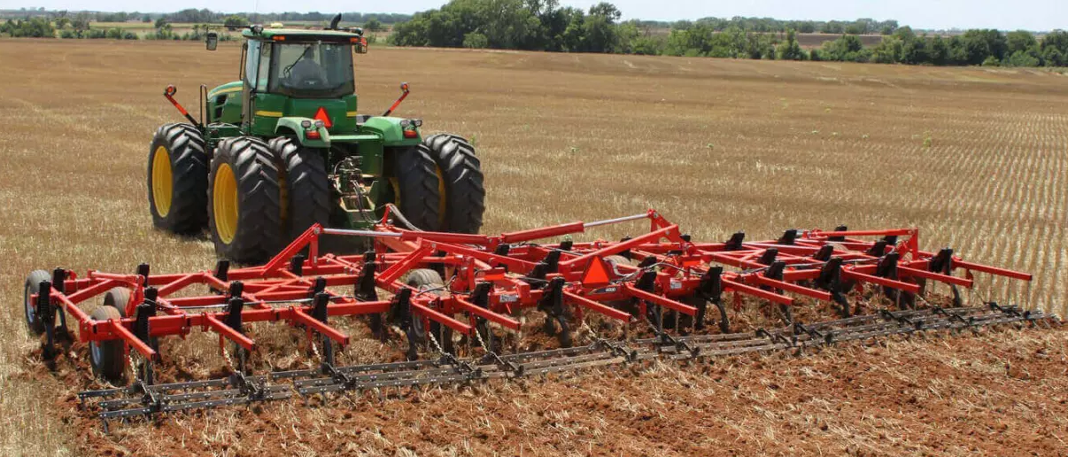
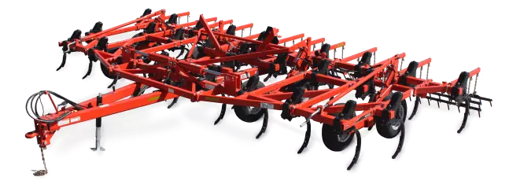
Chisel Plow
Loosens soil but leaves residue on the surface
Best used for breaking up compacted soil without excessive soil disturbance
Advantages: Reduced soil erosion (compared to moldboard plow).
Disadvantages: Doesn’t fully bury weeds or residue
2021 Wil-Rich Chisel Plow Video
Notes:
The chisel plow is an important tillage tool that helps loosen the soil while leaving crop residue on the surface. Unlike the moldboard plow, which completely inverts the soil, the chisel plow fractures compacted layers while maintaining surface residue.
This type of plow is best used for breaking up compacted soil without excessive disturbance, which is especially important in areas where soil erosion is a concern. By maintaining residue cover, it helps reduce water runoff and wind erosion while still improving soil aeration and root penetration.
Some of the advantages of a chisel plow include:
Reduced soil erosion compared to the moldboard plow since it doesn’t completely overturn the soil.
Improved soil structure over time, as it helps break up hardpan layers without completely disrupting the microbial activity in the topsoil.
However, there are also disadvantages to consider:
It doesn’t fully bury weeds or crop residue, which means additional weed control methods may be needed.
Some fields with heavy residue may require multiple passes or additional secondary tillage to create a smooth seedbed.

Slide 7
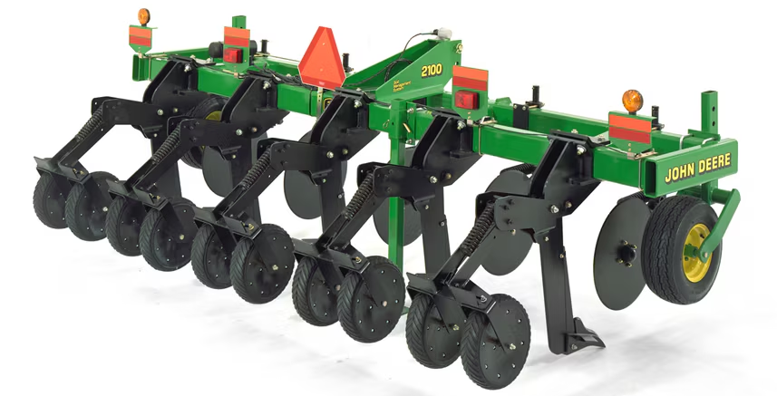
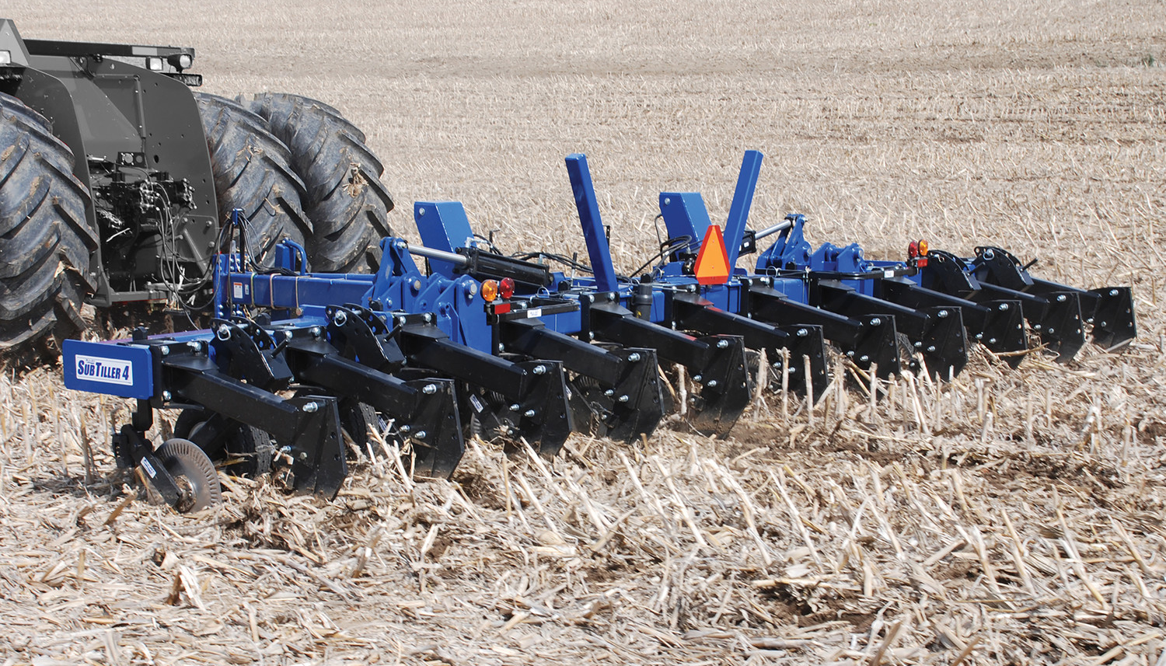
Ripper/Subsoil plow
Uses deep shanks to break up soil deep below the surface without turning the soil over
Best used for breaking up compacted soil layers
Advantages: relieves soil compaction, improves drainage, preserves soil structure
Disadvantages: High Horsepower requirements, does not mix residue.
How to Use a Ripper / Field Cultivator - Gardening Series
Notes:
The ripper or subsoil plow is a deep tillage tool designed to break up compacted soil layers without completely turning the soil over. It uses deep shanks to penetrate well below the surface, typically 12 to 24 inches deep, loosening the subsoil while leaving most of the topsoil undisturbed.
This type of plow is best used for alleviating compaction that occurs over time due to heavy machinery or repeated crop cycles. Soil compaction can restrict root growth, reduce water infiltration, and lower crop yields, making tools like the ripper essential for maintaining long-term soil health.
Some of the key advantages of using a ripper include:
Relieves soil compaction, allowing roots to grow deeper and access more nutrients.
Improves drainage, preventing water from pooling on the surface.
Preserves soil structure by breaking up compaction without excessive soil disturbance, making it a more conservation-friendly option compared to traditional plows.
However, there are also some disadvantages to consider:
High horsepower requirements—rippers need powerful tractors to pull them through the soil, which can increase fuel costs.
Does not mix residue—unlike other tillage tools, rippers do not incorporate crop residue into the soil, which may require additional passes with other equipment for residue management.

Slide 8
What is Secondary Tillage?
Secondary tillage is the process of preparing soil for planting after primary tillage.
Effects of secondary tillage
Breaks up large clods from primary tillage
Improves seed-to-soil contact
Reduces weed competition
Helps with moisture conservation
Depth: Shallower - 2-6 inches
Common primary tillage implements include
Field Cultivator
Disk Harrow
Rolling Baskets/Soil Conditioner
Notes:
After primary tillage, farmers often use secondary tillage to further refine the soil and prepare it for planting. Secondary tillage is a shallower process, typically working at a depth of 2 to 6 inches, and is focused on creating a smooth, well-prepared seedbed.
Effects of Secondary Tillage:
It breaks up large soil clods left behind by primary tillage, making it easier for seeds to establish.
It improves seed-to-soil contact, which is essential for good germination and uniform crop emergence.
It reduces weed competition by disrupting young weed seedlings before they can establish.
It helps with moisture conservation, as a well-prepared seedbed retains moisture more effectively, benefiting early crop growth.
Common Secondary Tillage Implements:
Field Cultivators – Used to smooth and level the soil while incorporating residue.
Disk Harrows – Break up clods and mix soil to improve tilth.
Rolling Baskets/Soil Conditioners – Help firm the soil surface and improve seedbed uniformity.
While secondary tillage is useful for creating ideal planting conditions, excessive tillage can lead to soil erosion and moisture loss.

Slide 9
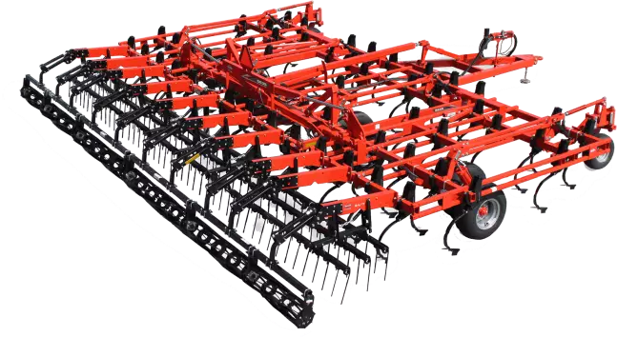
Field Cultivator
Uses rows of shanks to aerate the soil while breaking up large clods
Best used for preparing a smooth and even seedbed and for light weed control
Advantages: helps incorporate herbicides and fertilizers, low fuel and horsepower requirements
Disadvantages: Less effective in high-residue fields and has a limited penetration depth
Notes:
The field cultivator is a secondary tillage tool designed to aerate the soil, break up large clods, and create a smooth seedbed. It is commonly used after primary tillage to refine soil conditions before planting.
Best Uses:
Preparing a smooth and even seedbed to ensure good seed-to-soil contact.
Light weed control, as the shanks disturb small weeds before they become established.
Advantages:
Helps incorporate herbicides and fertilizers, improving soil nutrient distribution.
Low fuel and horsepower requirements, making it more cost-effective than deep tillage tools.
Maintains soil moisture better than aggressive tillage methods.
Disadvantages:
Less effective in high-residue fields, since it does not bury residue as well as a disk harrow or moldboard plow.
Limited penetration depth, meaning it is not effective for breaking up deep compaction layers.
Field cultivators are a great option for farmers looking to prepare their fields efficiently without excessive soil disturbance. However, they are often combined with other tillage tools to manage residue and soil structure effectively.

Slide 10
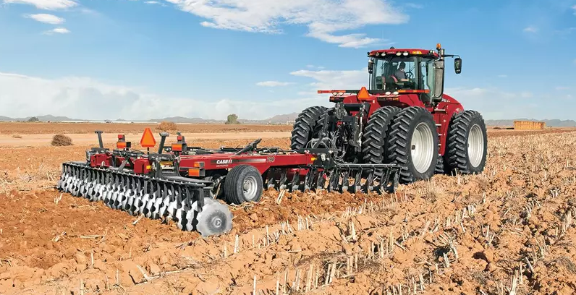
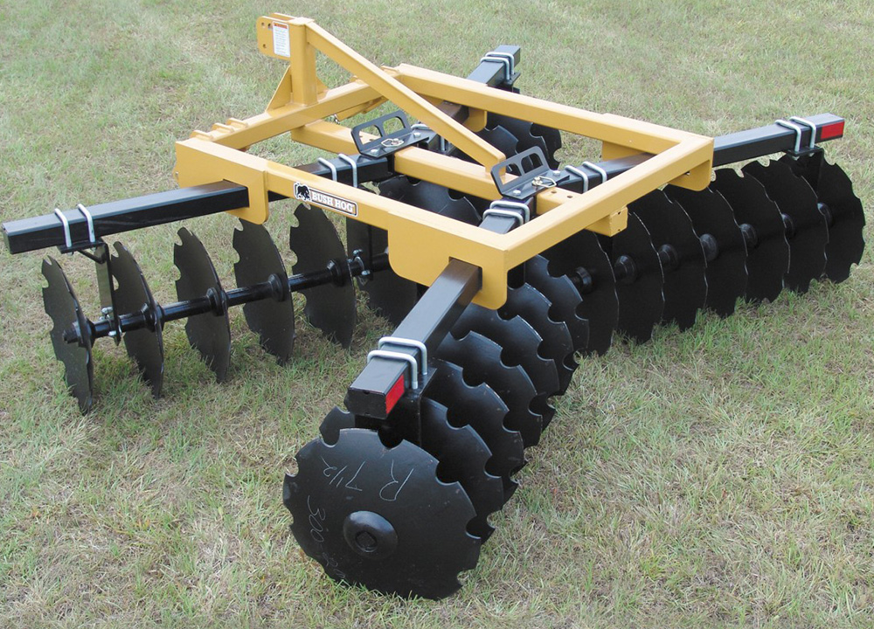
Disk Harrow
Uses rows of concave disks to slice through the soil and mix residue
Best used for breaking clods of dirt and smoothing soil after primary tillage
Advantages: Good for incorporating residue and herbicides. Can be adjusted for different soil conditions
Disadvantages: Multiple passes may be needed, high risk of compaction
How to Use a Disc Harrow - The Gardening Series
Notes:
The disk harrow is a secondary tillage tool that uses rows of concave disks to slice through the soil and mix residue. It is particularly effective at breaking up soil clods, smoothing out rough fields, and incorporating crop residue left behind after primary tillage.
Best Uses:
Breaking up clods of dirt that remain after plowing, helping to create a more uniform seedbed.
Smoothing the soil surface to prepare for planting.
Incorporating residue and herbicides to aid in nutrient cycling and weed control.
Advantages:
Great for mixing residue into the soil, which can improve organic matter and soil fertility.
Can be adjusted for different soil conditions, making it a versatile tool for various field types.
Speeds up decomposition of plant material, reducing disease pressure and improving soil health.
Disadvantages:
Multiple passes may be needed to fully break down large clods, increasing fuel and labor costs.
High risk of compaction, especially if used repeatedly at the same depth, as it can create a compacted layer known as a "hardpan."
Overall, disk harrows are a popular tool for refining soil conditions before planting, but they need to be used carefully to avoid compaction

Slide 11
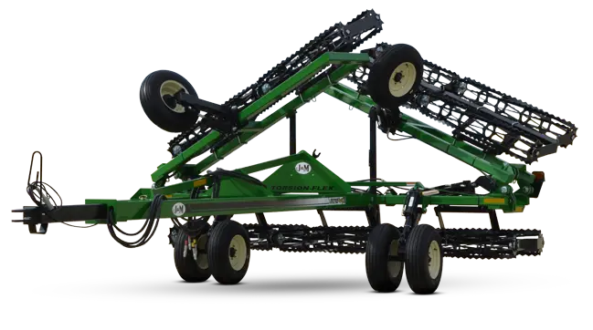
Rolling Basket/Soil Conditioners
Rollers with metal bars break up small clods and firm the soil surface
Best used for final soil preparation before planting
Advantages: Prevents soil crusting, enhances seed-to-soil contact
Disadvantages: Very limited affect on soil compaction, requires secondary tillage for best results
K-AG Basket Rollers | Farming - YouTube
Notes:
The rolling basket or soil conditioner is a secondary tillage tool used for final seedbed preparation before planting. It consists of rollers with metal bars that break up small soil clods and firm the soil surface, helping to create an ideal environment for seed germination.
Best Uses:
Final soil preparation after primary and secondary tillage.
Improving seed-to-soil contact by breaking up remaining clods and creating a fine-textured seedbed.
Reducing soil crusting, which can hinder seed emergence, particularly in fine-textured soils.
Advantages:
Prevents soil crusting, which helps seedlings emerge more easily.
Enhances seed-to-soil contact, which improves germination rates.
Can be used in combination with other tillage tools for an even smoother seedbed.
Disadvantages:
Limited impact on soil compaction, meaning it does not break up deep compaction layers like rippers or subsoilers.
Requires prior secondary tillage for best results, as it works more as a finishing tool rather than a primary soil preparation method.
While rolling baskets do not significantly alter soil structure, they are an excellent finishing step for preparing the perfect seedbed. Many farmers use them in combination with field cultivators or disk harrows to refine the soil before planting

Slide 12
Summary
 | Primary Tillage | Secondary Tillage
Depth | Deep (6-24 inches) | Shallow (2-6 inches)
Purpose | Initial soil preparation | Seedbed refinement
Tools Used | Plows, Subsoiler | Harrows, Cultivator
Timing | First operation | After primary tillage

